Slide 1
Electric Vehicle Charging Station Recommendation System
Mid-term defence of
Rajat Budhathoki | 20820/075
Bipin Chaudhary | 20800/075
Abhinna Ojha | 20788/075

Slide 2
Introduction
The big problem of EVs have been the range per charge.
There are limited EV charging stations and it can be very difficult for people to find the nearest charging station.
System aims to provide users a web-based platform that can detect the nearest charging station on their location and provide the shortest route to the available charging station

Slide 3
Objectives
To implement Cosine Similarity algorithm to implement collaborative filtering
To build a web-based system to recommend EV charging station in a specified location

Slide 4
Schedule analysis

Slide 5
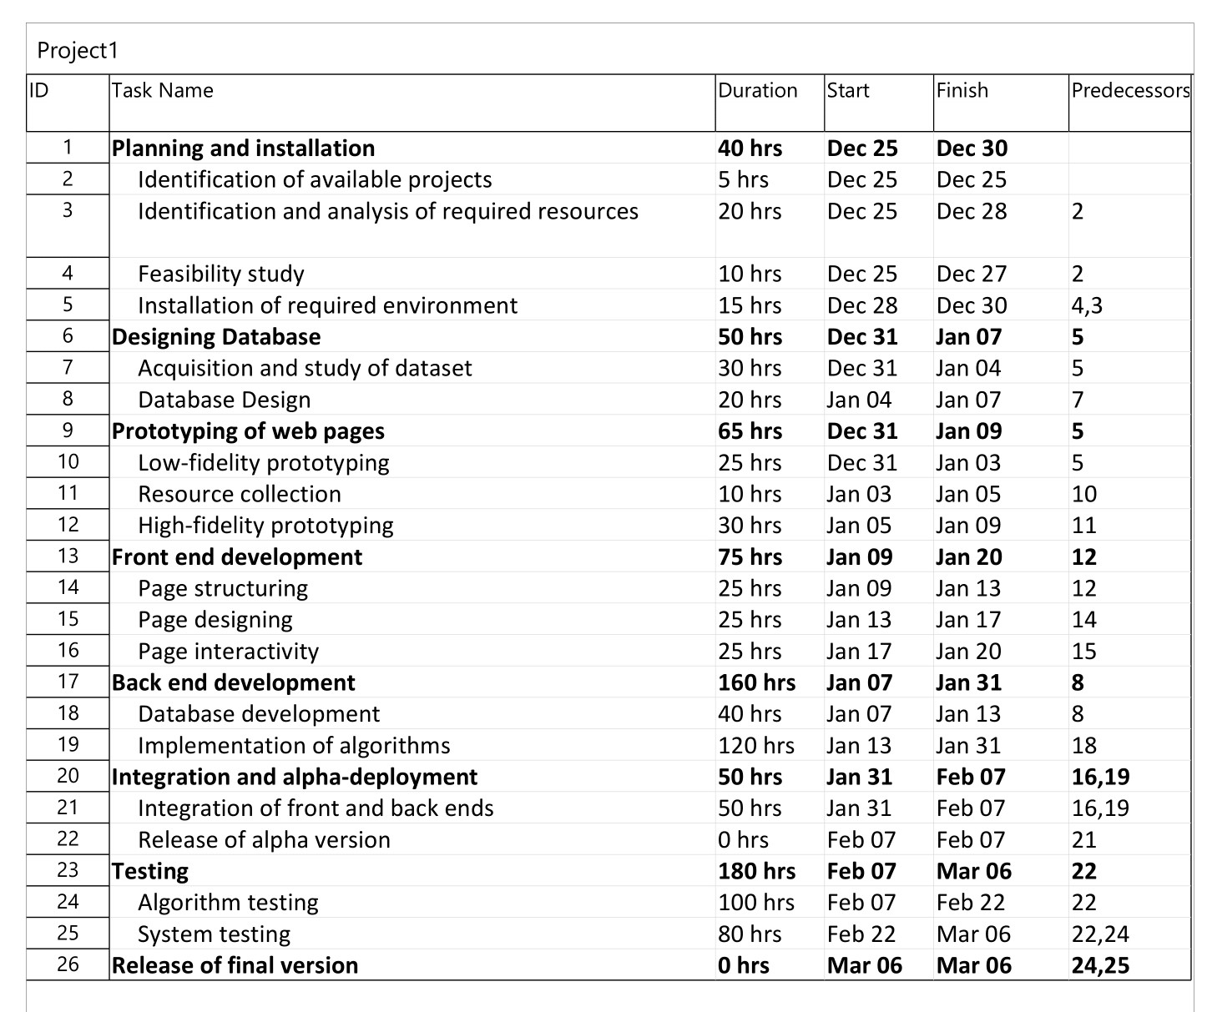

Slide 6
Use case diagram

Slide 7
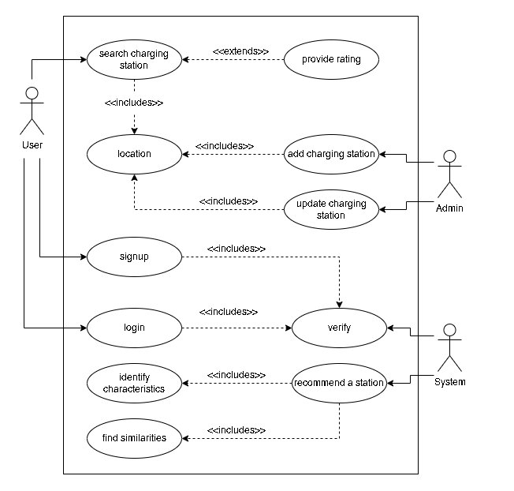

Slide 8
Activity diagram

Slide 9
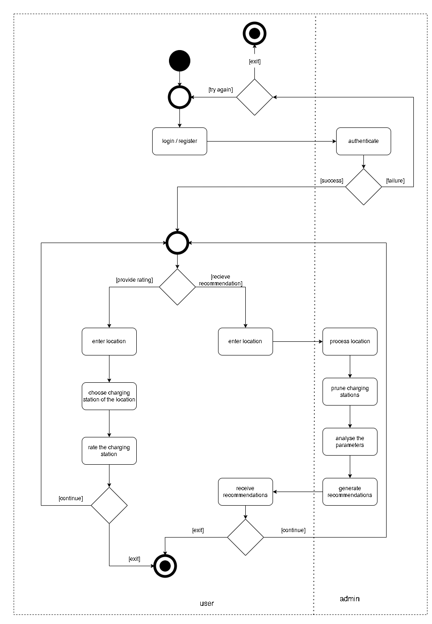

Slide 10
Database design and implementation

Slide 11
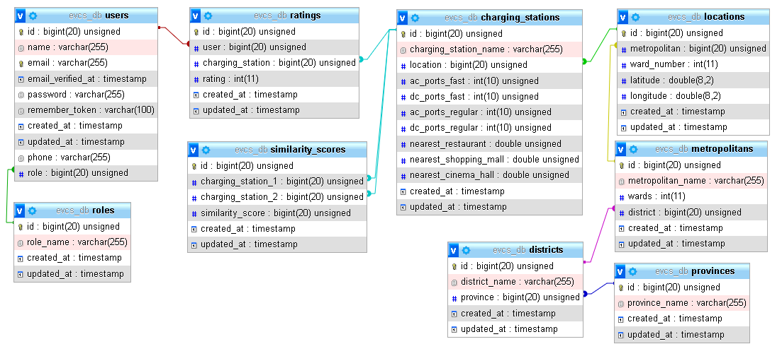

Slide 12
Thank You

